Slide 1
Book1 PORUS SHEET DASHBOARD
File created on: 10/30/2023 8:30:41 AM

Slide 2
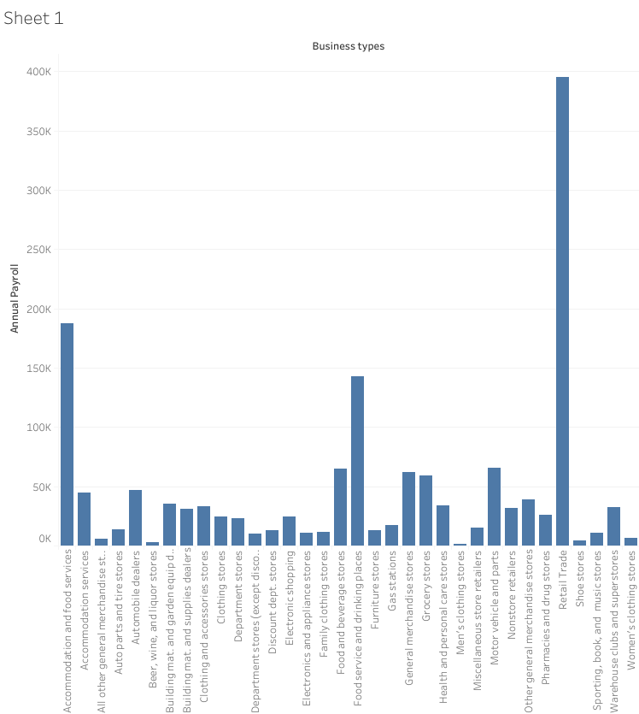

Slide 3


Slide 4
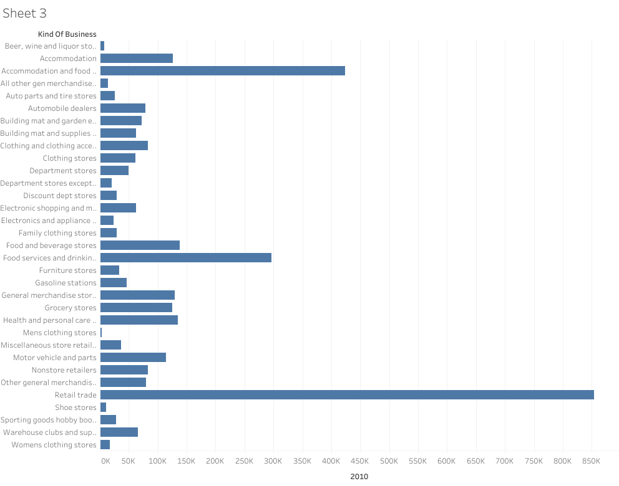

Slide 5
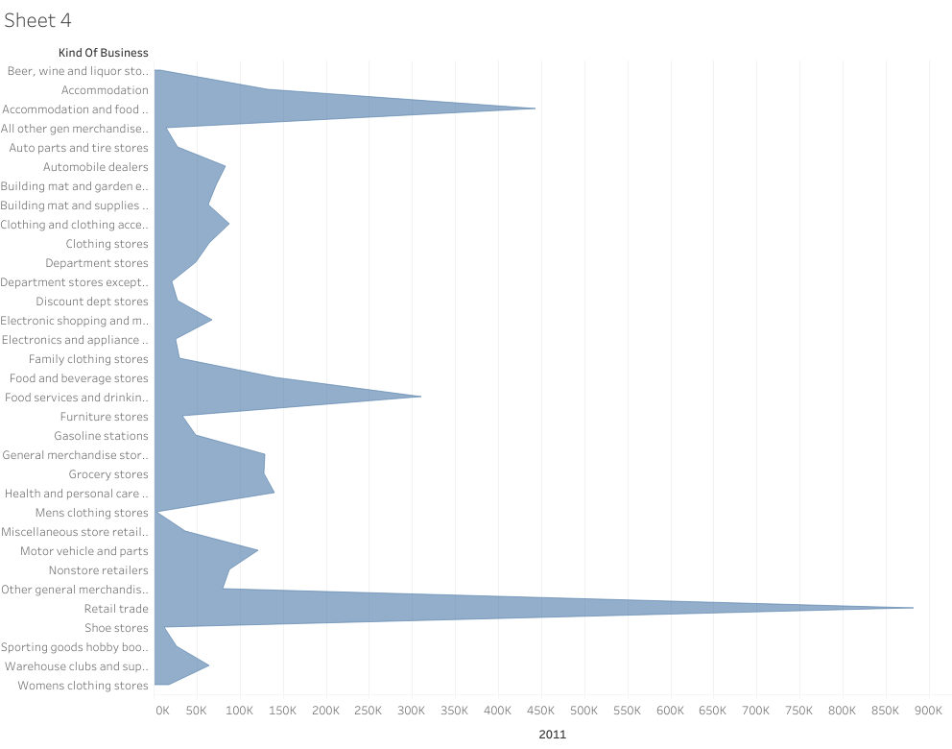

Slide 6
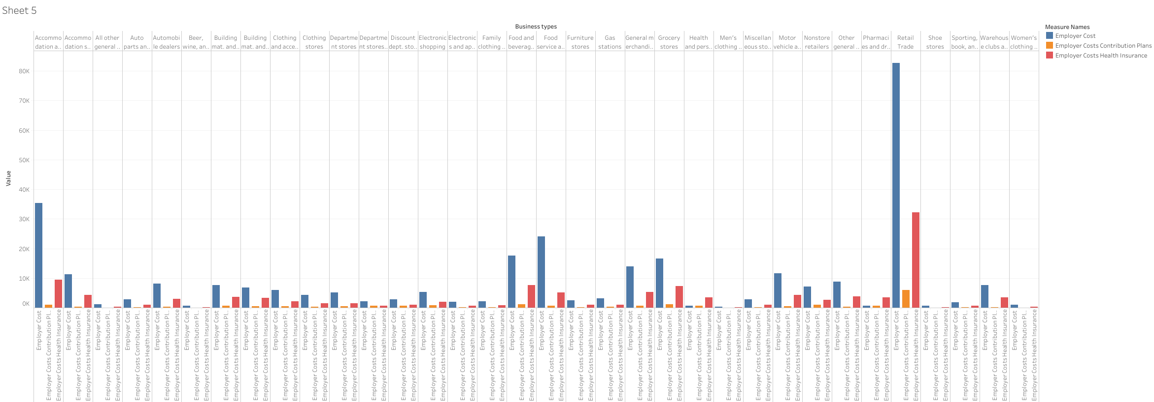

Slide 7
